Slide 1
0-1Knapsack problem
A knapsack problem is a constructive approach that is basically about a given set of items along with their weights and values.
So, the first step of the programmer is to set each item’s number so that it includes in the collection and finally to check whether the total weight is less than or equal to a specific limit.
The programmer also needs to ensure that the particular set is containing the maximum number of elements

Slide 2
Solutions of the problem
There are three solutions for knapsack problem:
1-Greedy method: in this method calculate the ratio of value and weight then choose the ratios by sorting them in descending order.
The first ratio is the maximum package number, so choose the first ratio.
You need to fill the knapsack until remain is greater than the weight when it crosses the weight the loop should break and display the output value.
Code in next slide

Slide 3
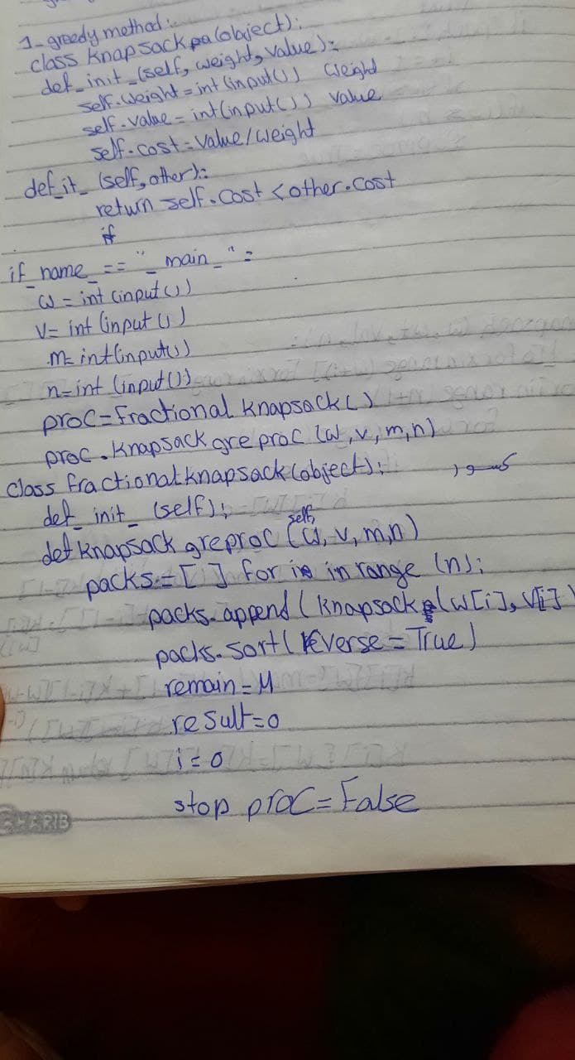

Slide 4
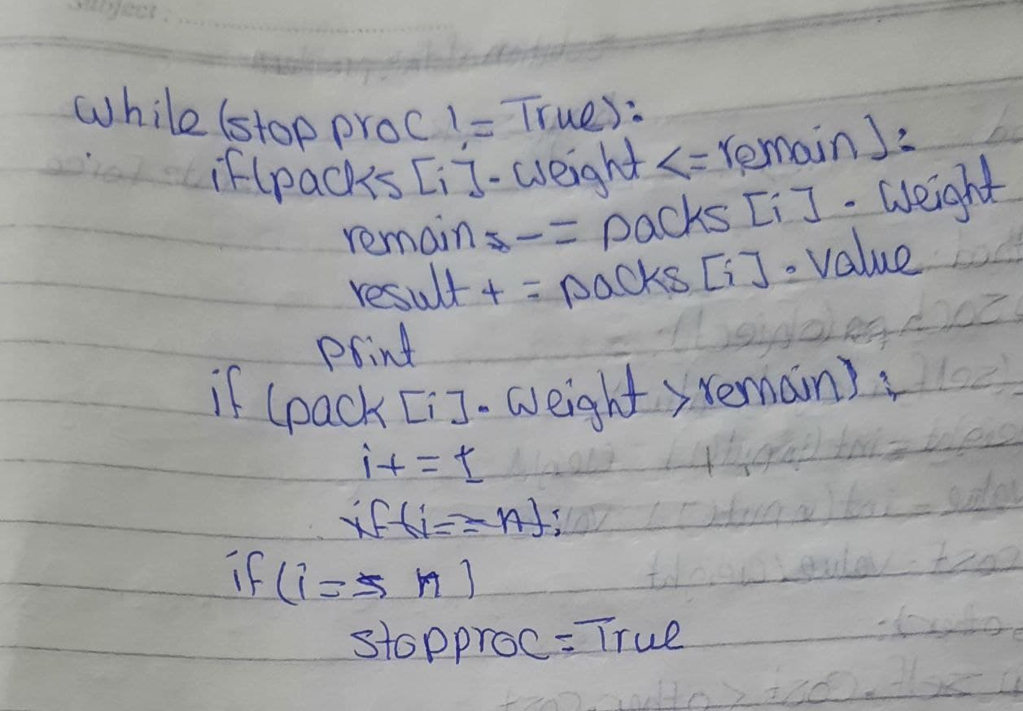

Slide 5
solution
2- dynamic programming:
the given problem is divided into subproblems.
The subproblems are again divided into many subproblems. They get divided until you get subproblems that can be easily solved.

Slide 6
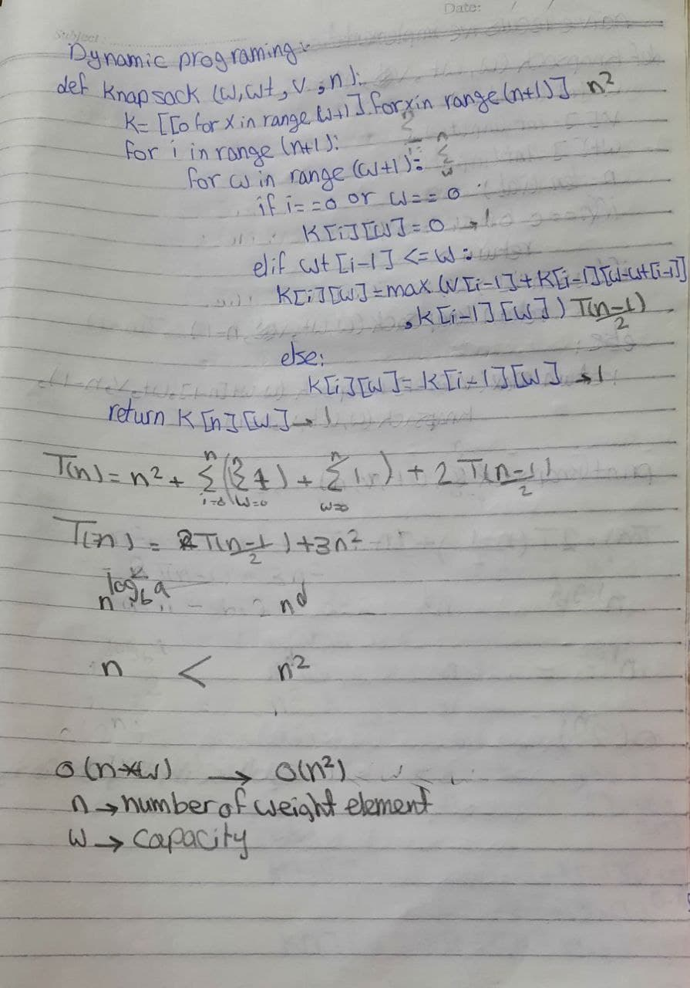
Dynamic programming:

Slide 7
Solution:
3-brute force:
solves the problem by checking if there are ‘n’ items from which you have to choose, then there is a possibility to get 2n combinations of elements in the Knapsack. Whether the item is either chosen or not, a bit-string of 0’s and 1’s is obtained, whose length will be equal to the number of items.
If the ‘i’th symbol of that string is 0, then consider that the item is not chosen. And if the ‘i’th symbol of that string is 1, consider the item as chosen.

Slide 8
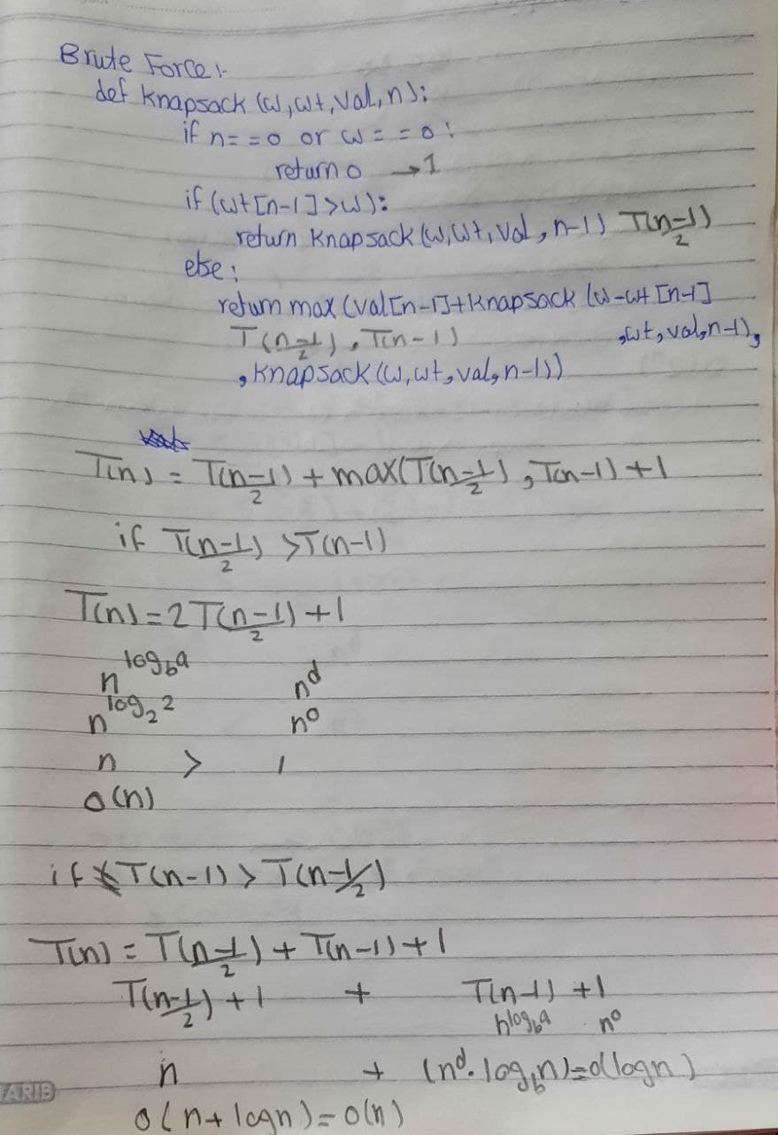
Brute force:

Slide 9
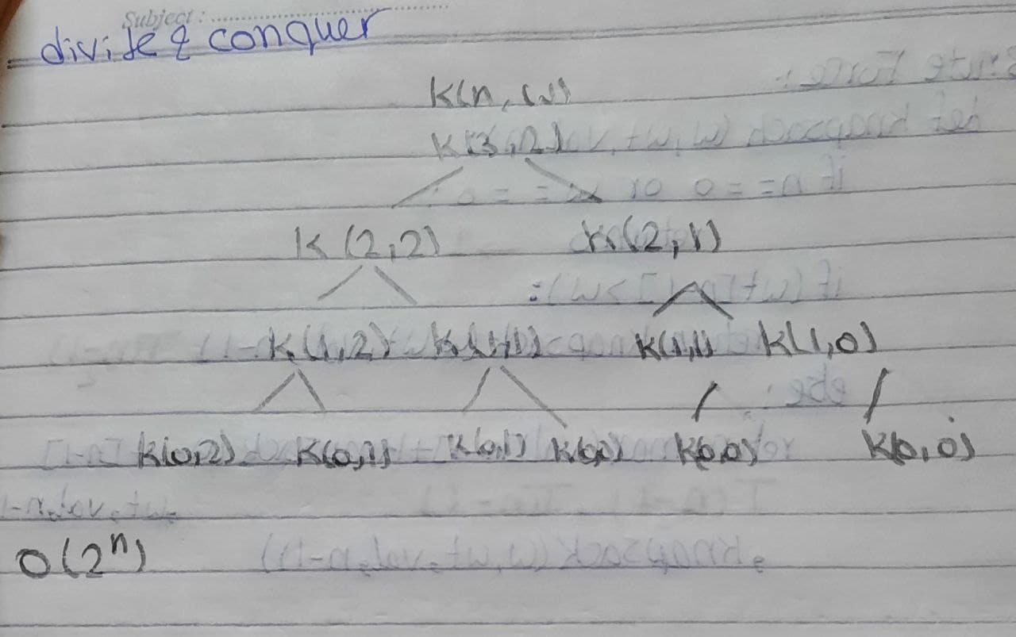
Divide and conquer

